Slide 1

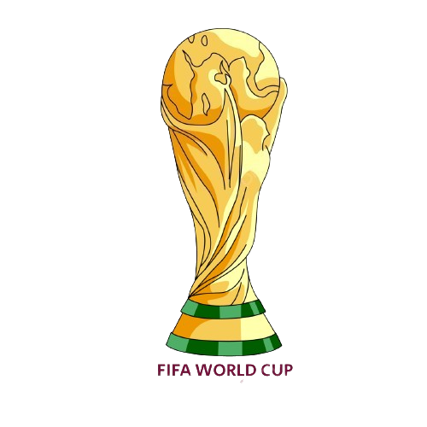



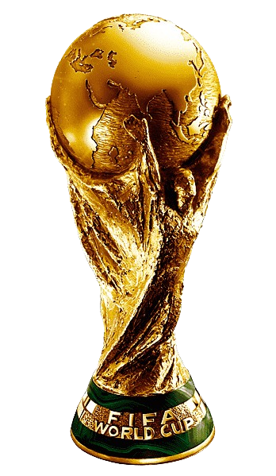
Football FIFA World Cup Analysis
Tushar Padavi
Data Analysis

Slide 2
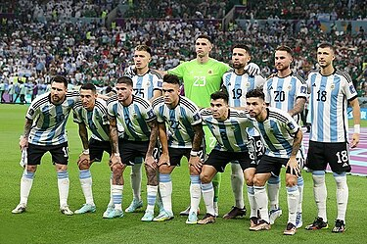
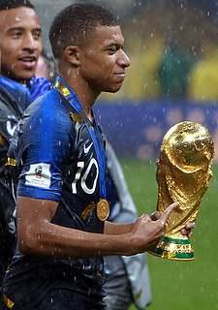
Introduction
.
.
The FIFA World Cup, often simply called the World Cup, is an international association football competition among the senior men's national teams of the members of the Fédération International de Football Association (FIFA), the sport's global governing body
The tournament has been held every four years since the inaugural tournament in 1930.
The primary objective is to compile a comprehensive report detailing key information such as the year of each tournament, the host country, the champion, the runner-up, the final score, and the number of participating teams. By meticulously collecting and organizing this data, the project aims to offer valuable insights into the historical trends and patterns of the FIFA World Cup. Furthermore, the project seeks to enhance data interpretation through the creation of insightful visualizations.

Slide 3
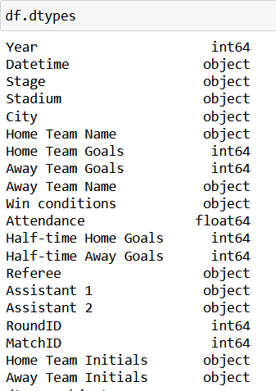
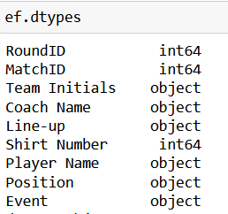
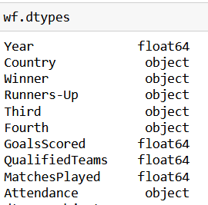
Details of Data
World Cup Matches
World Cup Players
World Cup

Slide 4
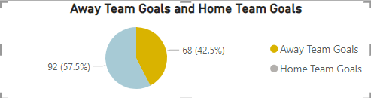
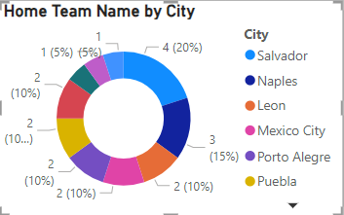
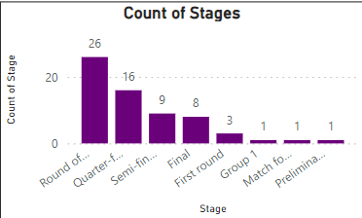
Mock – up Dashboard
The city with the highest count of home team names is Salvador, boasting four distinct teams. This distribution highlights the varied landscape of sports teams within different cities, indicating varying levels of sporting diversity and activity across regions
YEAR 1938, with 4.6% of records, 1986. with 7.7% of records: and 1934, with 3.1% of records, among others, most affect the distribution

Slide 5



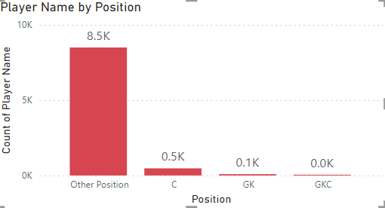
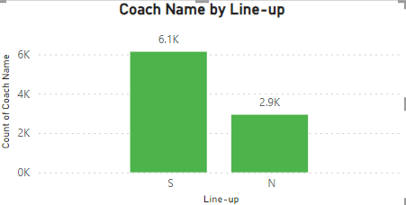
Dashboard Overview
No of the Players with Position.
No of Coach Line-up Matches

Slide 6
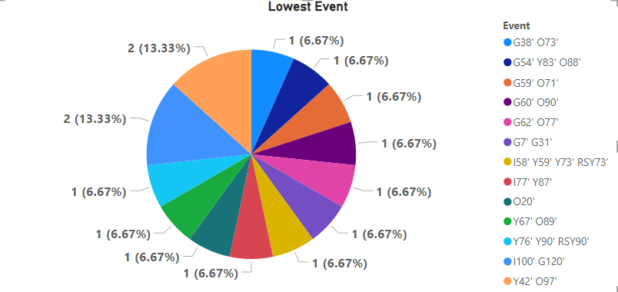
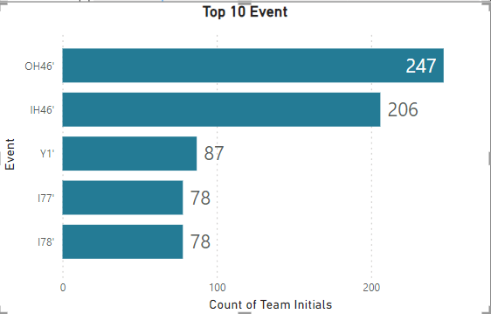
Dashboard Overview
Highest Frequency (13.33%):
Two events, denoted by the orange and light blue segments, each represent 13.33% of the total. These are events Y42' O97' and Y67' O89', indicating that these particular lowest scoring events have occurred more frequently.
Equal Distribution (6.67%):
The remaining 13 segments each represent 6.67% of the total, showing a relatively equal distribution among these events. This indicates that there is a variety of lowest scoring events, but no single event overwhelmingly dominates the others.
Top Event:
OH46' is the most frequent event with 247 team initials.
Second Event:
IH46' follows with 206 team initials.
Other Significant Events:
Y1' has 87 team initials.
I77' and I78' both have 78 team initials each.

Slide 7



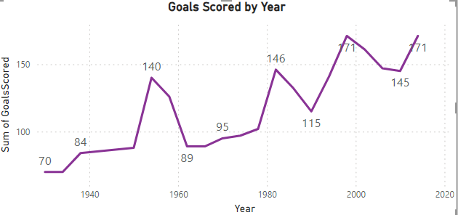
Dashboard Overview
This chart represents the total number of goals scored in each FIFA World Cup from 1930 to 2014.
Trend Analysis
1930 - 1950: Steady Increase
Starting from 70 goals in 1930, there was a steady increase in the number of goals scored, reaching 84 goals in 1950.
1954 - 1962: Fluctuations
A sharp increase to 140 goals in 1954, followed by a decline to 89 goals in 1962.
1970 - 1982: Peaks and Valleys
An increase to 95 goals in 1970, then a significant rise to 146 goals in 1982.
1986 - 1998: Variable Trends
Goals scored fluctuated, with 115 goals in 1990 and a peak of 171 goals in 1998.
2002 - 2018: Recent Trends
After a decline to 145 goals in 2014, it rose again to 171 goals in 2018.
Key Observations
1954 and 1982: High-scoring tournaments.
Post-1998: Consistent high goal counts, indicating possibly more attacking play or rule changes favoring offense.
Dips: Notable dips in 1962 and 1990, highlighting possibly stronger defenses or fewer matches played.

Slide 8
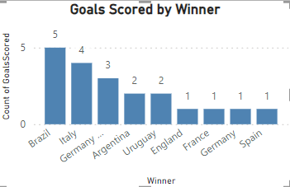
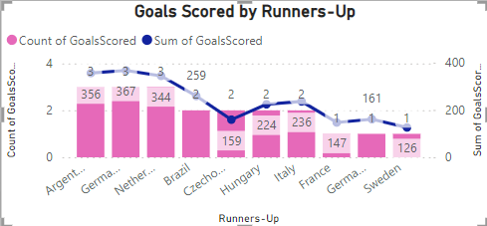
Dashboard Overview

Slide 9
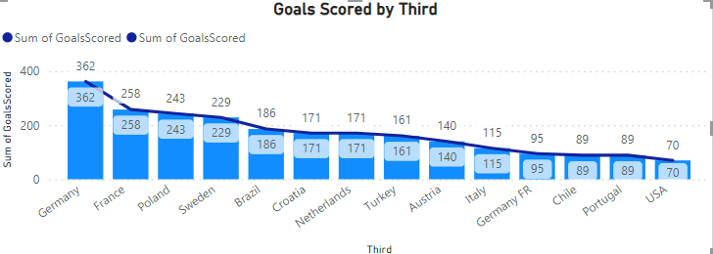
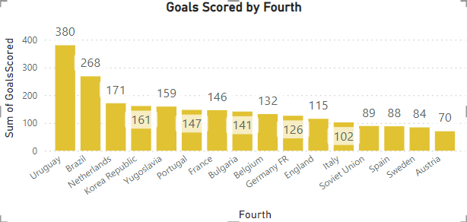
Dashboard Overview

Slide 10
Thank you

